Slide 1
Introduction
The Coffee & Cake_Group4
Supervisor:
Lê Thanh Nhân
Members:
Nguyen Dinh Nam_Student1387805
Tran Le Huy_Student1387806
Tran Hoang Tu_Student1387823
Month:03 Year:2023

Slide 2
Content
Introduction
Actual requirements
Requirements of the project
Deployment diagram
Test result
Conclusion and development
Task list

Slide 3
Introduction - Actual requirements
The Coffee & Cake is a simple web application designed to help users order and pay for coffee and cakes online. The app allows users to select products by category and view product details, including price and description. Users can order and pay online using popular payment methods such as credit cards or e-wallets. After placing an order, the user will receive a confirmation message about his order. Application administrators can manage products, orders, and customer information. The goal of the application is to provide a simple and convenient user experience when ordering online and to help administrators manage their business more easily. Based on the needs outlined in the project, we have designed an application that will provide the following features and functions.
.

Slide 4
Introduction - Requirements of the project
Functional
For user :
- Users can view products by name or description
- Users can place orders for products from the page.
- Users allows users to add products to their cart and place orders by entering the delivery address information
- Users can change the number of products or remove products from the cart.
- Users can view history orders.
- Can send Contact
Notes:
Non-functional (how the system works)
Functional (what the system should do)

Slide 5
Introduction - Requirements of the project
Functional
For admin :
- Can add/ edit admin’s account
- Can view/deactivate User
- Can add/ view/ deactivate Category
- Can add/view/edit/deactivate products
- Can view all orders and change status orders
- Can view Contact
Notes:
Non-functional (how the system works)
Functional (what the system should do)

Slide 6
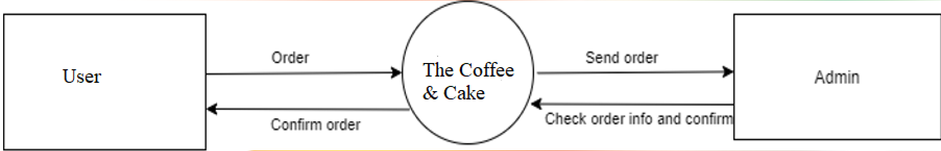
Introduction - Deployment diagram
Data Flow Diagram

Slide 7
Test Result
Functional | Table use | Actor | Status
Login Register Edit account information | User | User | Done
Filter product Add to cart product Order product | Product, Order, OrderDetails, Category | User | Done
View products View Order history | Product, User, Order, OrderDetails | User | Done
Send contact | Contact | User | Done

Slide 8
Test Result
Functional | Table use | Actor | Status
Login | User | Admin | Done
Category Management | Category | Admin | Done
Order Management | Order | Admin | Done
Admin’s account Management | User | Admin | Done
Product Management | Product | Admin | Done
- View Contact | Contact | Admin | Done

Slide 9
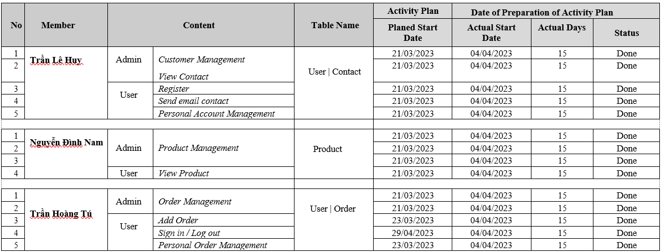
Task List

Slide 10

Thank You

